Slide 1
RetinaScope
AI-Based Retinal Vessel Segmentation &
Diabetic Retinopathy Detection
Aymen Slimani
TEAM Project
Retinohelpers
3rd Year Software Engineering
github.com/AYMENsl25/Retinal-dr-detection
0.8425
0.9598
9
40k
Vessel Dice
Grading QWK
Architectures
Grading Images

Slide 2



The Problem
Clinical Motivation
7M
25–35%
#1
Diabetic patients
in Turkey
Will develop
Diabetic Retinopathy
Cause of preventable
blindness (working-age)
Ophthalmologists are concentrated in urban centers.
Rural patients have NO access to screening. By the time they notice vision loss, DR is already at Grade 3–4 — requiring laser surgery or vitreoretinal surgery.
An AI-powered offline screening tool can shift detection to Grade 0–1, preventing blindness.
RetinaScope-AI v2 · Aymen Slimani · TÜBİTAK
Problem

Slide 3
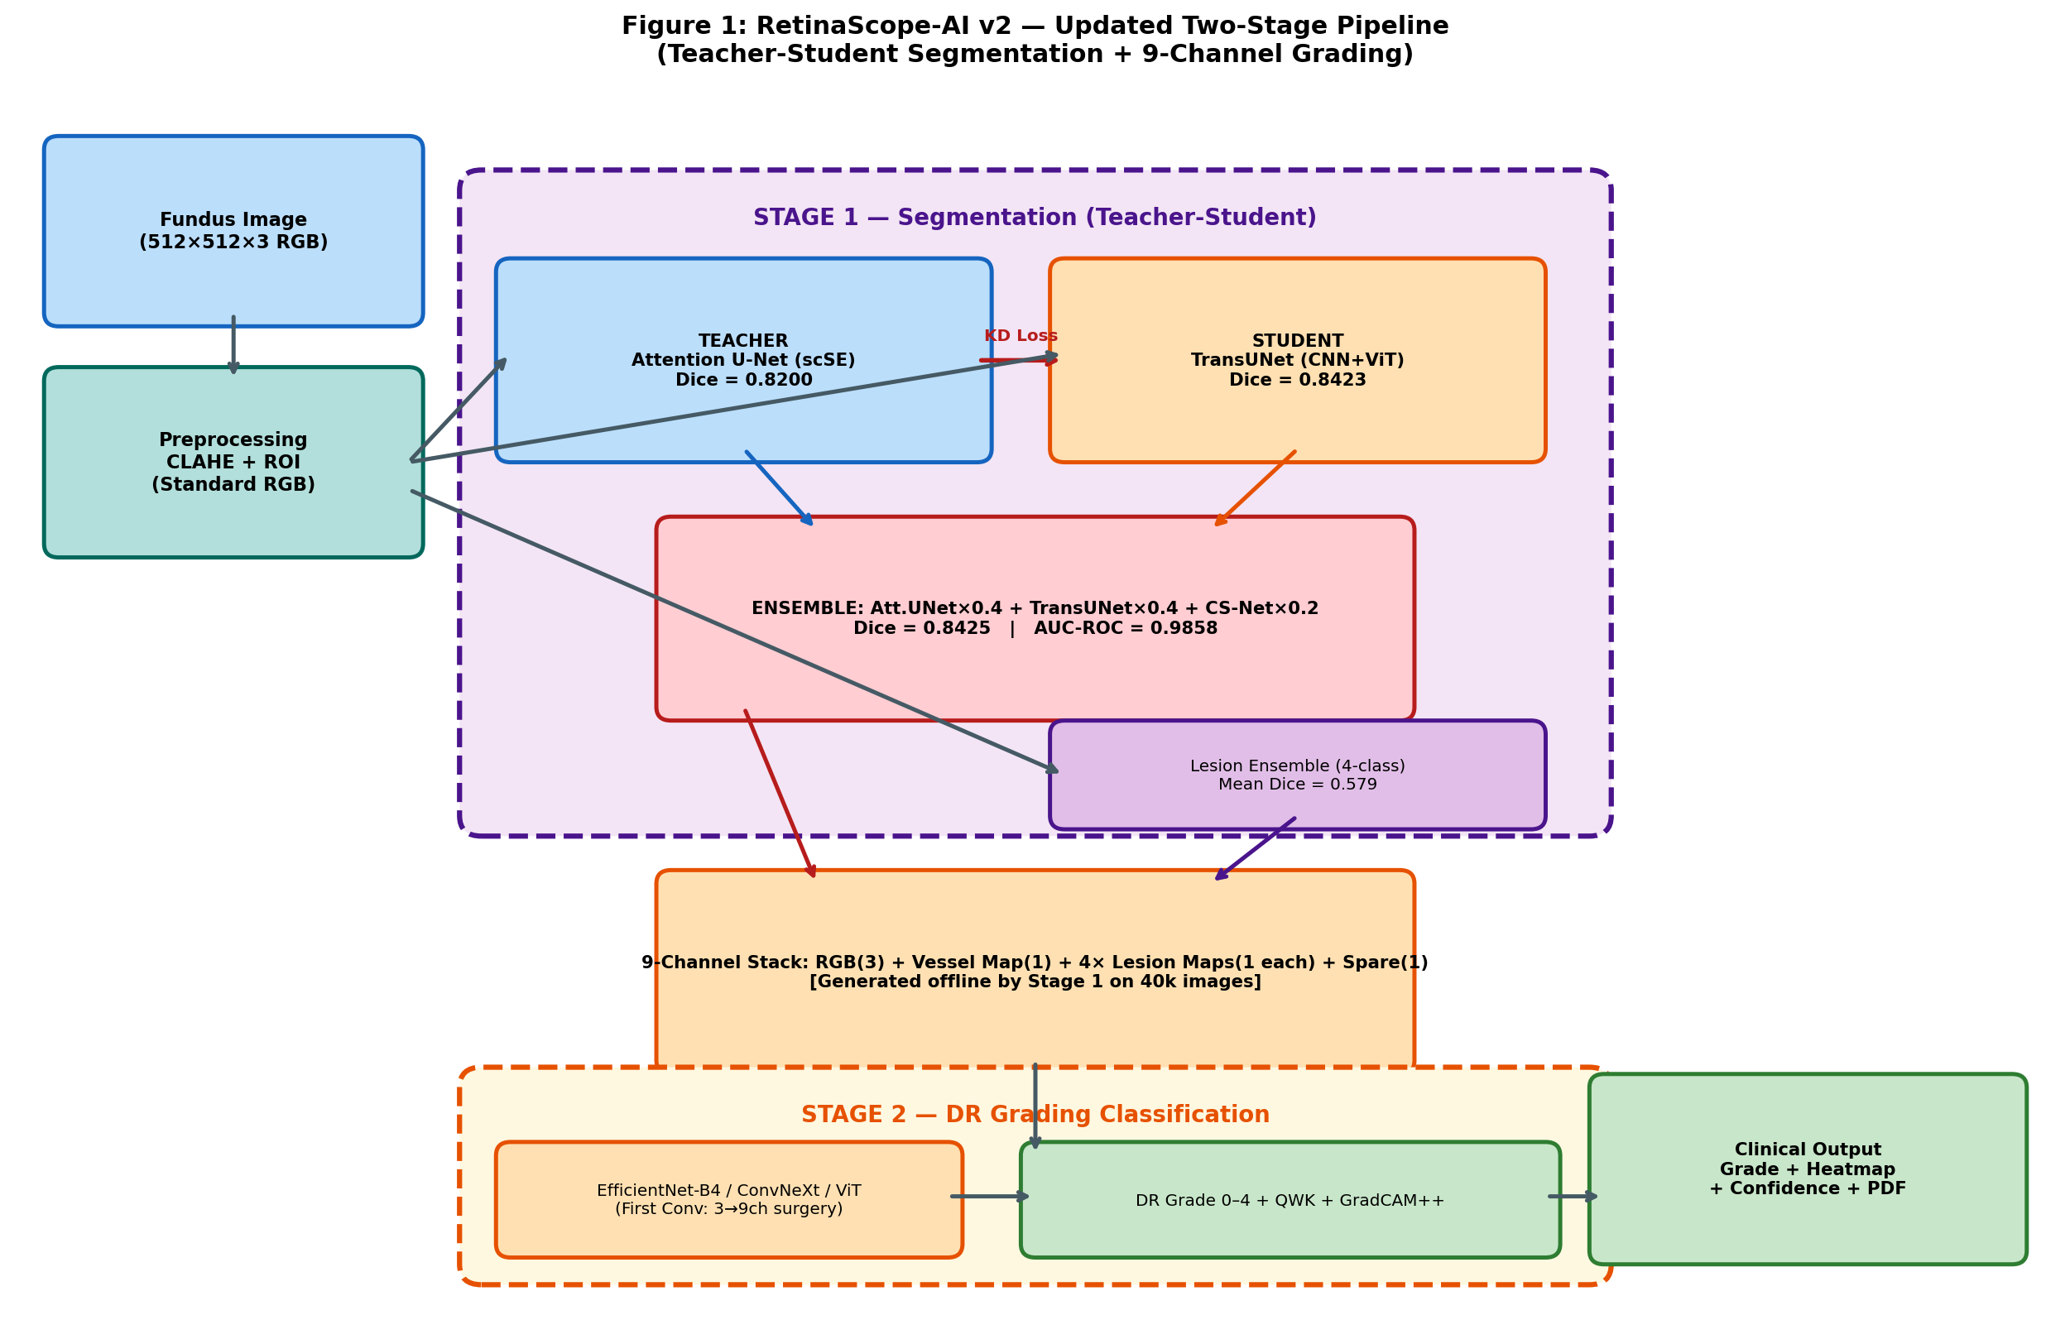


Our Solution: RetinaScope-AI v2
Two-stage deep learning pipeline for automated DR screening
Vessel Map
Binary segmentation of all retinal vessels
Lesion Maps
MA, HE, EX, OD — 4 pathological classes
DR Grade 0–4
Severity grading via 9-channel classifier
GradCAM++
Explainability heatmap for clinical trust
RetinaScope-AI v2 · Aymen Slimani · TÜBİTAK
Solution Overview

Slide 4
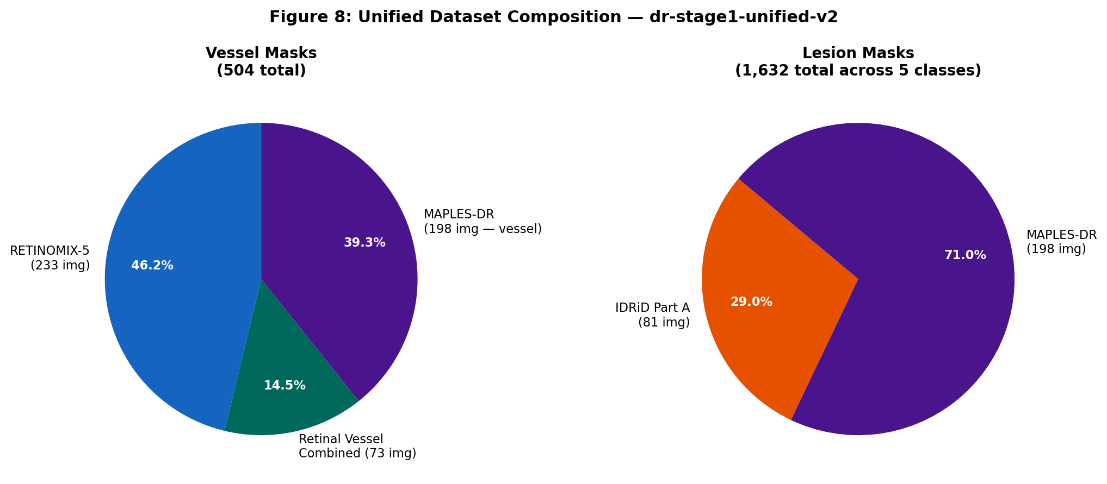
Dataset: dr-stage1-unified-v2
4 sources unified — published on Kaggle (CC BY 4.0)
585
1,632
Total Images
Lesion Masks
504
4
Vessel Masks
Source Datasets
Source | Images | Mask Type
RETINOMIX-5 | 233 | Vessel
Vessel Combined | 73 | Vessel
IDRiD Part A | 81 | Lesion (5 types)
MAPLES-DR | 198 | Vessel + Lesion
TOTAL | 585 | 504 vessel / 1,632 lesion
🔗 kaggle.com/aymenslimani/dr-stage1-unified-v2
RetinaScope-AI v2 · Aymen Slimani · TÜBİTAK
Dataset

Slide 5
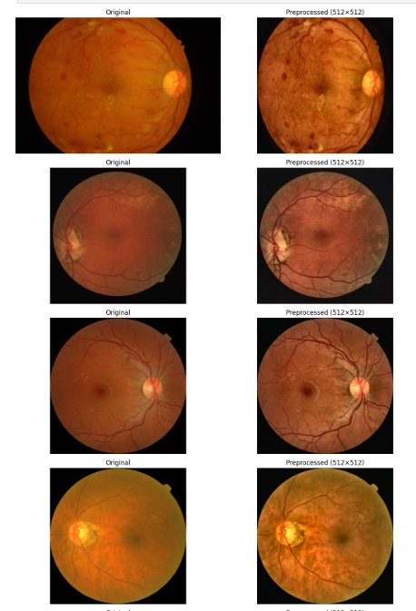
Preprocessing Pipeline
Standardized across all camera sources
01
Resize to 512×512
Standardize spatial dims across all datasets
02
CLAHE Enhancement
Contrast Limited Adaptive Histogram Equalization
03
ROI Circular Mask
Remove black vignette borders
04
ImageNet Normalize
mean=[0.485,0.456,0.406] std=[0.229,0.224,0.225]
Original → Preprocessed (512×512)
RetinaScope-AI v2 · Aymen Slimani · TÜBİTAK
⚠ Green Channel Injection ablation: mixed results (±0.003 Dice) — RGB retained as standard
Preprocessing

Slide 6
Stage 1: Vessel Segmentation — 9 Architecture Benchmark
Identical CFG across all models — fair, controlled comparison
Architecture | Category | Dice ↑ | AUC-ROC ↑
U-Net (ResNet34) | CNN Baseline | 0.7924 | 0.9751
U-Net++ | CNN Baseline | 0.7922 | 0.9712
Attention U-Net ★ TEACHER | Advanced CNN | 0.8200 | 0.9801
CS-Net | Advanced CNN | 0.8156 | 0.9825
FSG-Net | Advanced CNN | 0.7885 | 0.9701
Swin-UNet | Transformer | 0.7925 | 0.9740
TransUNet ★ STUDENT (KD) | CNN+Transformer | 0.8423 | 0.9852
🏆 Ensemble (Final) | Att×0.4+Trans×0.4+CS×0.2 | 0.8425 | 0.9858
Why Controlled?
Same optimizer, LR, loss, augmentation & data split
across all 9 models.
Performance differences = Architecture only
0.8200
0.8423
Teacher
(Att.UNet)
Student
(TransUNet)
0.8425
Final Ensemble Dice
RetinaScope-AI v2 · Aymen Slimani · TÜBİTAK
Stage 1 — Benchmark

Slide 7
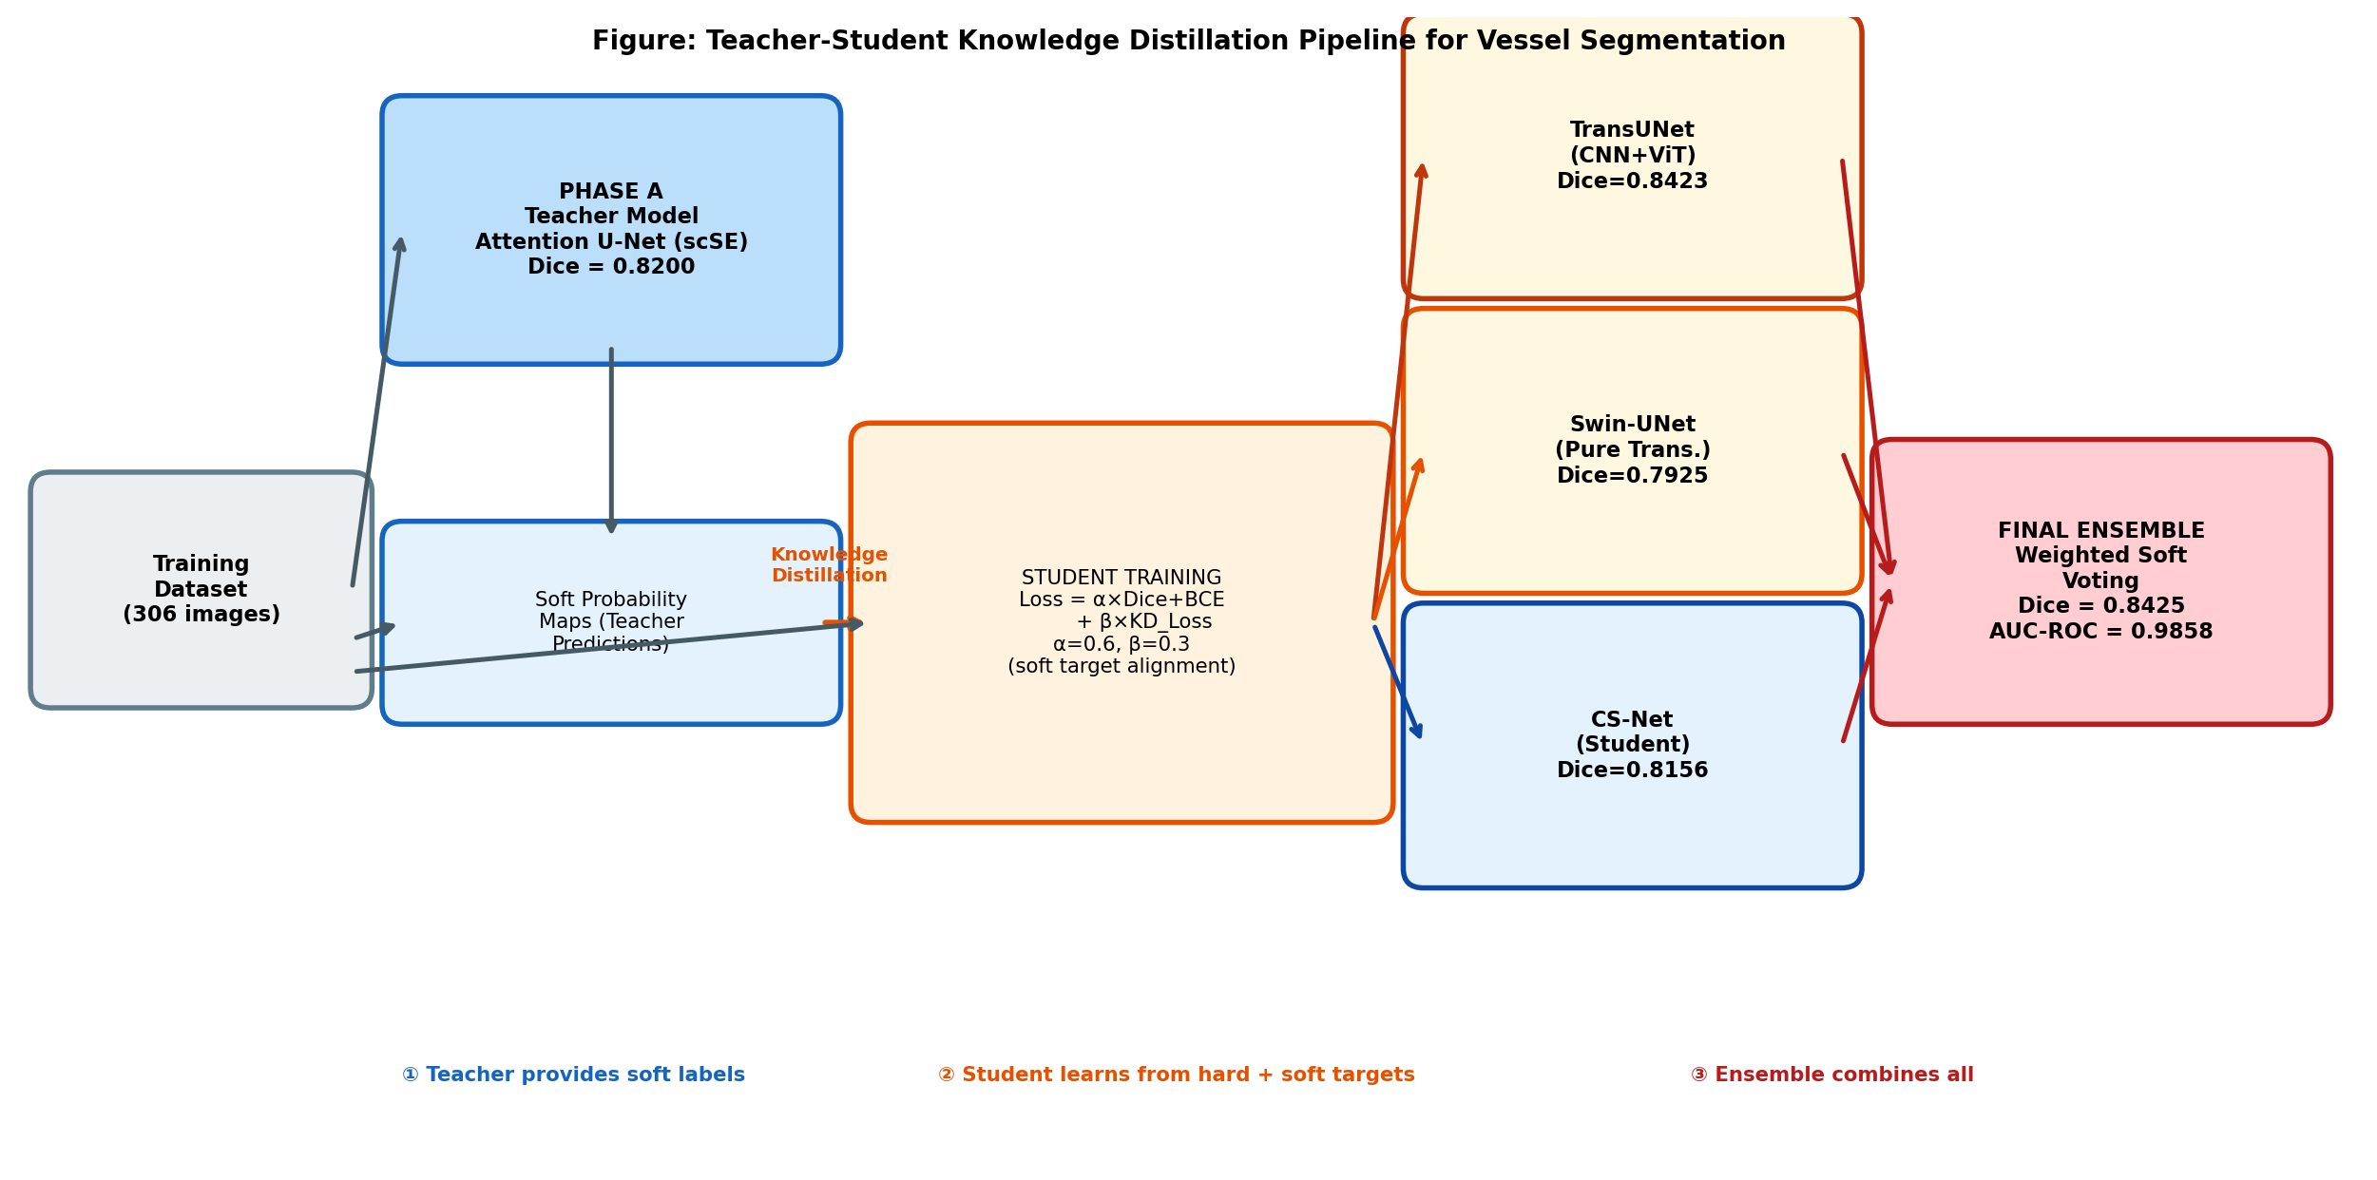
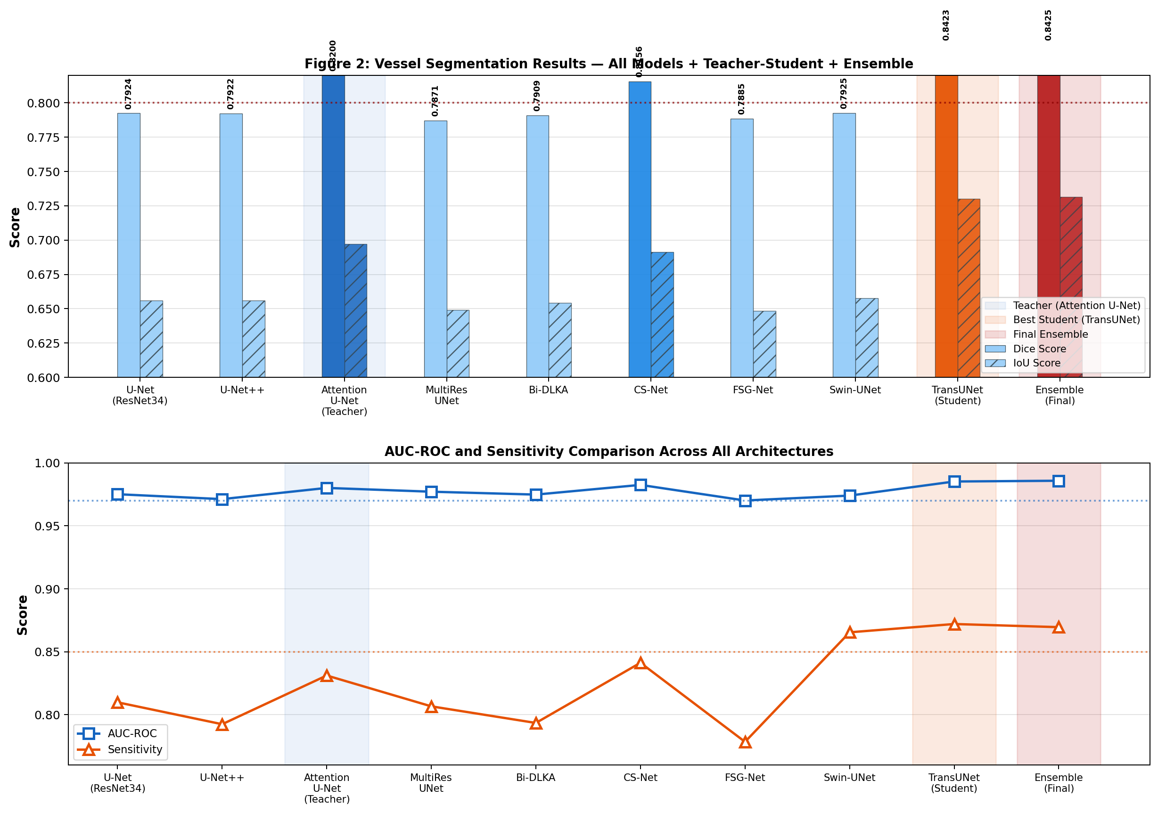
Teacher-Student Knowledge Distillation
Soft-label supervision from CNN teacher → Transformer student
KD Loss Formula
L = 0.6×(Dice+BCE)
+ 0.3×KD_MSE
+ 0.1×Aux
Dice Improvement
Teacher (Att.UNet)
0.8200
Student (no KD)
0.7891
Student (with KD)
0.8423
Ensemble
0.8425
+0.0223 gain
RetinaScope-AI v2 · Aymen Slimani · TÜBİTAK
Teacher-Student KD

Slide 8
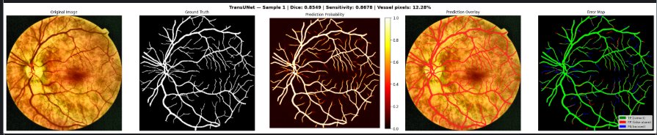
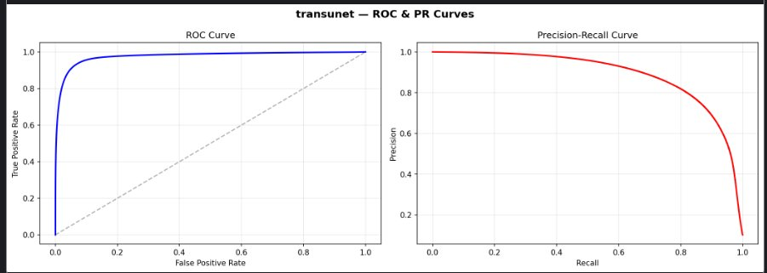
Vessel Segmentation — Qualitative Results
TransUNet (Student) prediction on test sample
TransUNet (Student) | Dice = 0.8349 | Sensitivity = 0.8678 | Vessel pixels: 12.28%
0.8425
Dice
0.7315
IoU
0.9858
AUC-ROC
0.8695
Sensitivity

Slide 9
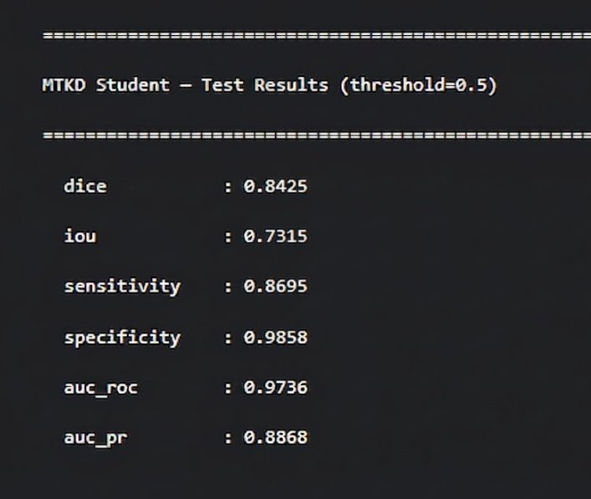
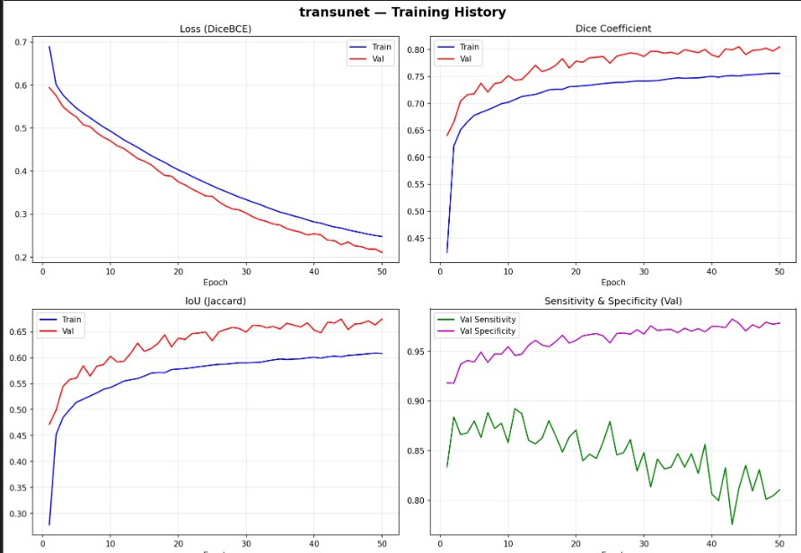
Final MTKD Student — Test Results
MTKD Results
0.8425
0.7315
0.9736
0.8868
0.9858
Dice
IoU
AUC-ROC
AUC-PR
Specificity
RetinaScope-AI v2 · Aymen Slimani · TÜBİTAK
MTKD Test Results

Slide 10
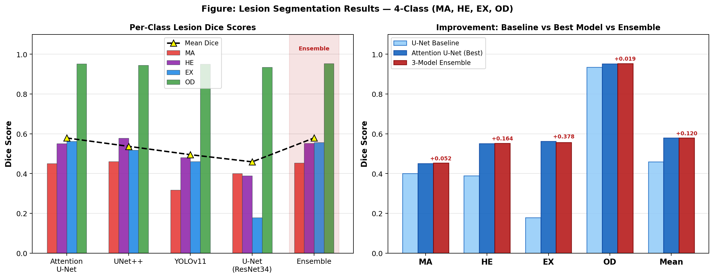
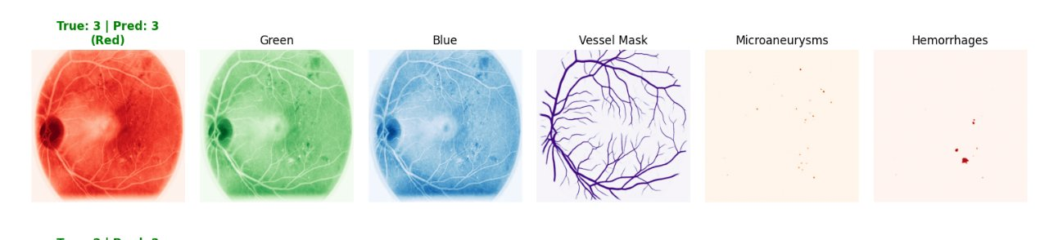
Stage 1: Lesion Segmentation — 4-Class
Per-channel weighted loss to handle extreme pixel imbalance
Channel Weights
MA (Microaneurysms)
Dice: 0.453
Weight: × 3.0
HE (Haemorrhages)
Dice: 0.553
Weight: × 2.5
EX (Exudates)
Dice: 0.556
Weight: × 1.5
OD (Optic Disc)
Dice: 0.953
Weight: × 0.5
9-Channel Input Visualization: Red / Green / Blue / Vessel Mask / Microaneurysms / Hemorrhages (True: Grade 3 | Pred: Grade 3)
RetinaScope-AI v2 · Aymen Slimani · TÜBİTAK
Lesion Segmentation

Slide 11
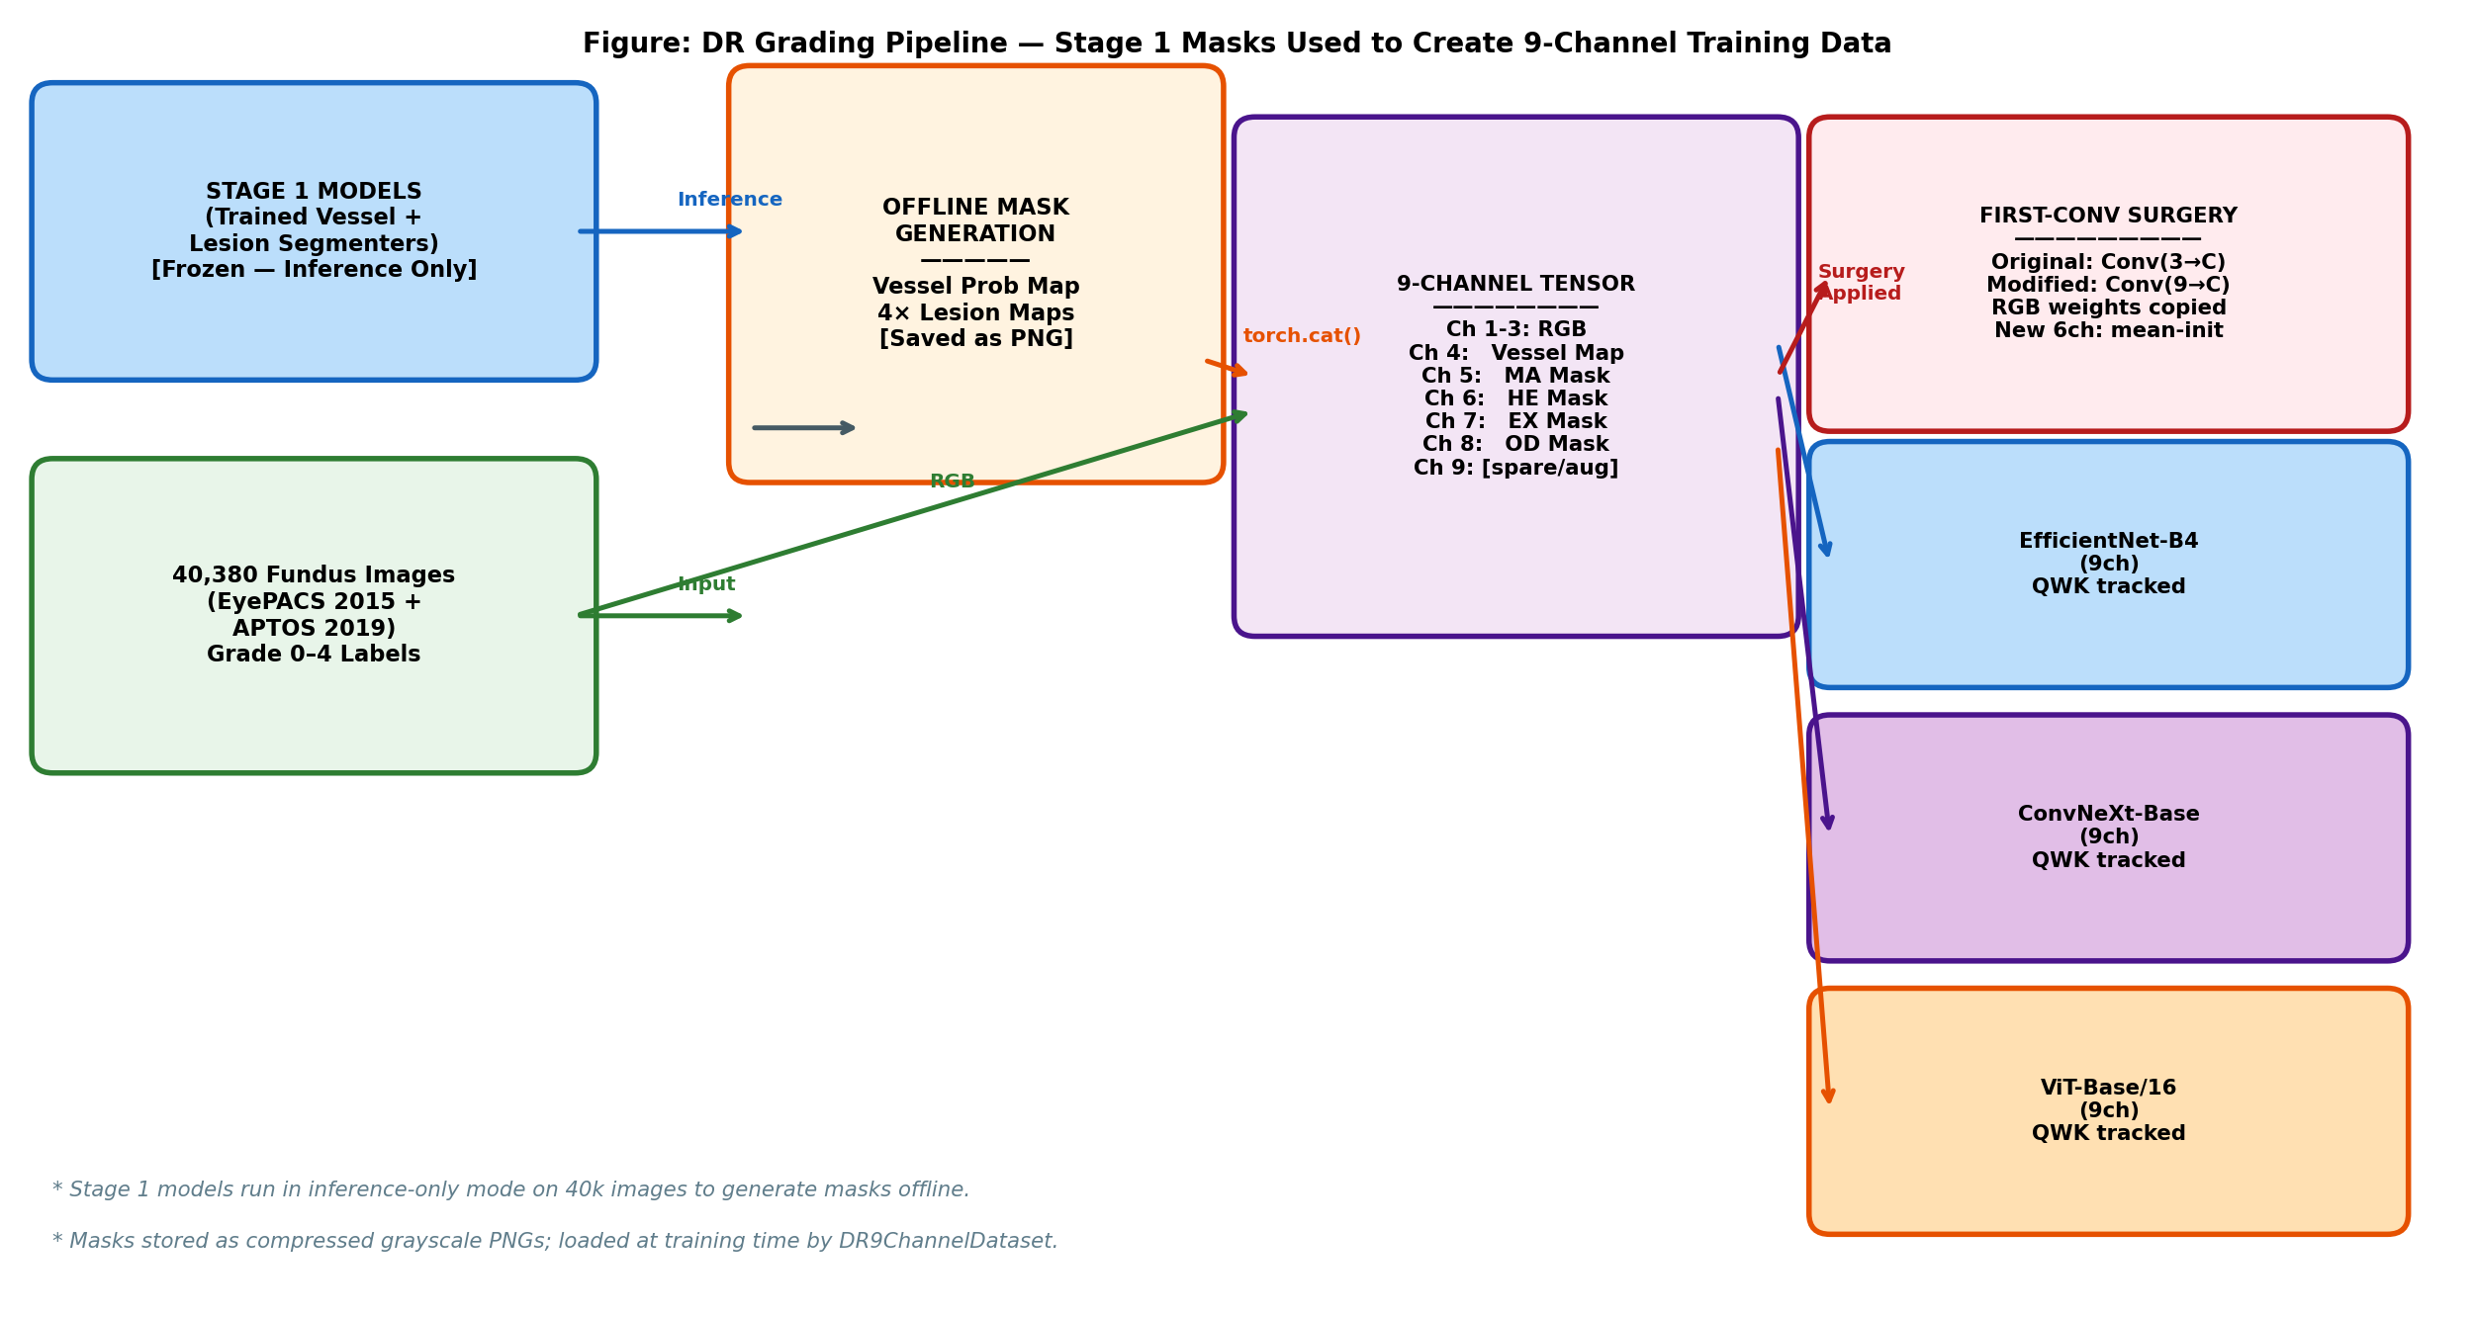
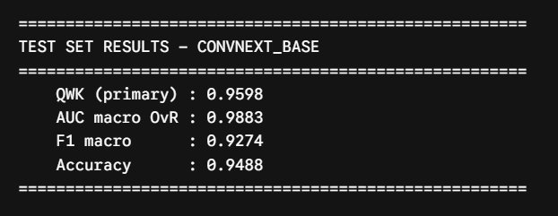
Stage 2: 9-Channel DR Grading Classification
First-Conv Surgery: in_channels 3 → 9, ImageNet weights preserved
0.9598
0.9883
QWK (primary)
AUC macro
0.9274
0.9488
9 Channels = RGB(3) + Vessel(1) + MA(1) + HE(1) + EX(1) + OD(1) + Spare(1)
ConvNeXt-Base | QWK=0.9598 | AUC=0.9883 | F1=0.9274 | Acc=0.9488
F1 macro
Accuracy
First-Conv Surgery: Copy RGB weights to ch 0-2
Init ch 3-8 with mean(RGB weights)
RetinaScope-AI v2 · Aymen Slimani · TÜBİTAK
Stage 2 — Grading

Slide 12
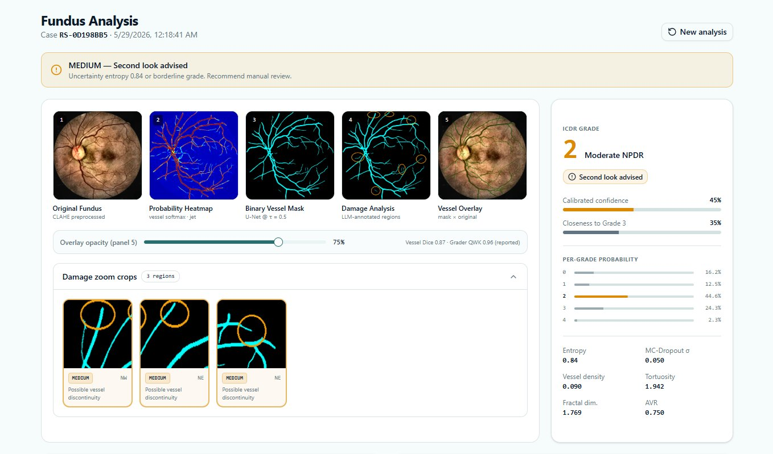
Live Demo — RetinaScope-AI Web Application
FastAPI + React
Grade 2 — Moderate NPDR
Per-Grade Probabilities
Vessel & Damage Panels
MC Dropout σ = 0.050
RetinaScope-AI v2 · Aymen Slimani · TÜBİTAK
Live Demo
ICDR Grade + confidence 45%
Full softmax distribution shown
5-panel visualization + zoom crops
Uncertainty quantification built-in

Slide 13
Results Summary
All targets met or exceeded
Objective | Target | Achieved | Status
Vessel Dice | ≥ 0.80 | 0.8425 | ✅ Exceeded
Vessel AUC-ROC | ≥ 0.97 | 0.9858 | ✅ Exceeded
Teacher→Student KD gain | > 0 | +0.0223 | ✅ Confirmed
Lesion Mean Dice (4-class) | ≥ 0.55 | 0.579 | ✅ Exceeded
Grading QWK (ConvNeXt) | ≥ 0.80 | 0.9598 | ✅ Achieved
Grading AUC macro | ≥ 0.95 | 0.9883 | ✅ Exceeded
FastAPI end-to-end verified | Pass | All 6 models loaded | ✅ Verified
Green Channel Ablation | Document | Mixed ±0.003 | ✅ Completed
RetinaScope-AI v2 · Aymen Slimani · TÜBİTAK
Results Summary

Slide 14
Deployment
Currently live — Edge deployment as next milestone
✅ LIVE NOW — Web Application
🗓️ FUTURE — Jetson Nano Edge Device
✓ FastAPI backend — REST API
NVIDIA Jetson Nano (4GB)
✓ React frontend — Clinical UI
Edge inference — fully offline
✓ Full pipeline: Vessel + Lesion + Grade
Portable Fundus Camera
EE sub-team — $200–500 vs $30k
✓ GradCAM++ explainability heatmap
TensorRT INT8 Quantization
✓ MC Dropout uncertainty score
Target: < 2s inference/image
✓ PDF clinical report export
No internet required
✓ Gemini Flash LLM explanation
Rural clinic deployment ready
✓ No specialist required
Qt touchscreen interface
7-inch display with grade + heatmap
[ Jetson Nano + Portable Camera screenshot to be added ]
RetinaScope-AI v2 · Aymen Slimani · TÜBİTAK
Deployment

Slide 15
Future Work
Three directions — short / mid / long term
Short Term
Mid Term
Long Term
Complete grading: EfficientNet-B4 + ViT-Base/16 training runs
Lesion improvement: Tversky loss + patch training → target Dice > 0.67
Jetson Nano: TensorRT INT8 → sub-2s inference + portable camera integration
Cross-dataset validation on IDRiD Part B holdout (516 images)
Per-channel threshold optimization (free +1–3% Dice)
Phase B custom arch: BiFormer + EMCAD + DDSP → target Dice > 0.85
GradCAM++ validation with ophthalmology reviewer
Test-Time Augmentation (8× geometric) → +2–4% Dice
Research paper submission (IEEE Trans. Medical Imaging)
RetinaScope-AI v2 · Aymen Slimani · TÜBİTAK
Future Work

Slide 16
Thank You
Questions?
Key Contributions
Links & Resources
▸ Unified public dataset (585 images, CC BY 4.0)
GitHub:
github.com/AYMENsl25/
Retinal-dr-detection
▸ Teacher-Student KD: Dice 0.8200 → 0.8423 (+0.0223)
Dataset:
kaggle.com/aymenslimani/
dr-stage1-unified-v2
▸ 9-architecture controlled benchmark
▸ 9-channel grading: QWK=0.9598, AUC=0.9883
Best Model:
MTKD Ensemble
Dice = 0.8425
▸ Deployed FastAPI + React web application
Grading:
ConvNeXt-Base
QWK = 0.9598
Aymen Slimani · Software Engineering · Istanbul University-Cerrahpasa · 2026

